Slide 1
BREAST CANCER DETECTION

Slide 2
ADA UNIVERSITY GEORGE WASHINGTON UNIVERSITY
Instructor | Dr. Jamalladin Hasanov
Students | Asiman Mammadzada Minura Hajisoy Narmina Mahmudova Rumiyya Alili
Notes:
This is the question that your experiment answers

Slide 3
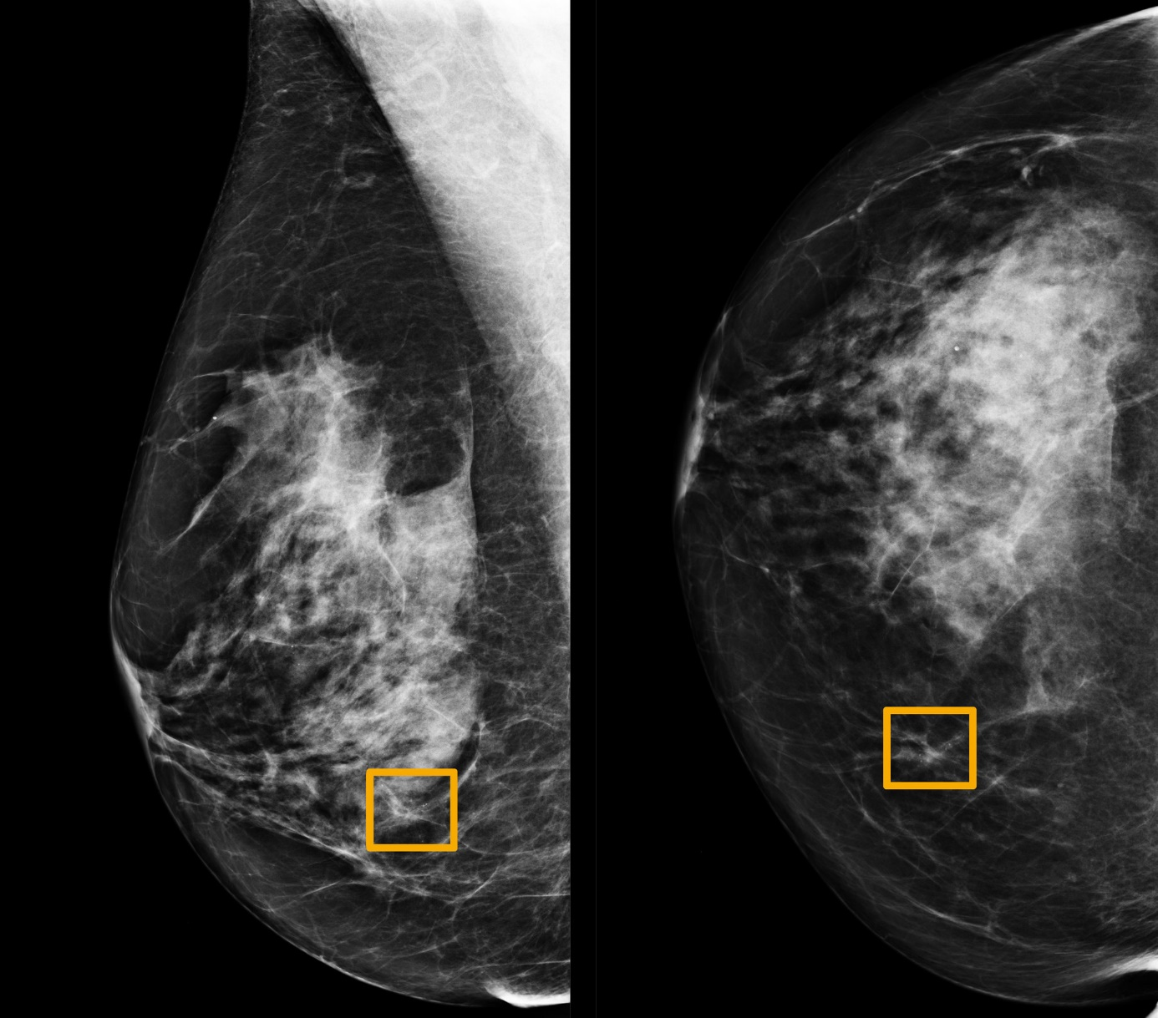
Breast cancer is the most commonly occurring cancer in women and the most common cancer overall. There were more than 2.26 million new cases of breast cancer in women in 2020. Moreover, the statistics from “cancer.org” indicates that, about 287,850 new cases of invasive breast cancer has been diagnosed in women in United States alone. Out of them, 43250 women has died. Based on these factors, breast cancer is believed to be one of the main problems of the society in 21st century.

Slide 4
Breast Cancer Detection based on Thermographic Images using Machine Learning and Deep Learning Algorithms
by Allugunti (2021)

Slide 5
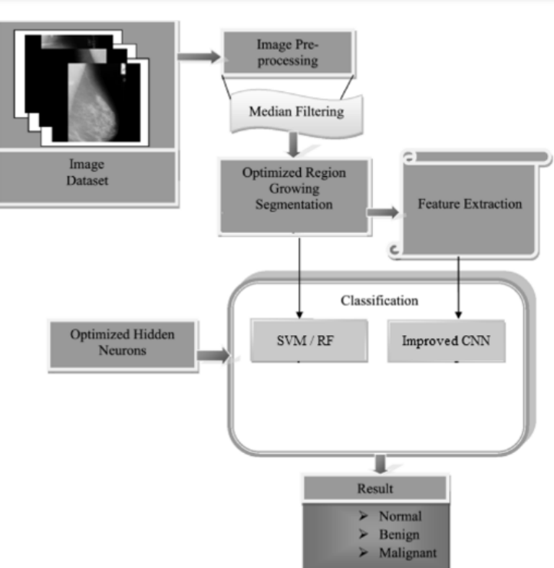
The author experimented Convolutional Neural Network (CNN), SVM and Random Forest Classifier on the dataset of over 150 patients, either with or without breast cancer, totaling over 1000 photographs. The data was scaled to have dimensions of 128x128 pixels each.
Image dataset should be input into the system.
Image quality can be improved by performing pre-processing on the image.
From the input picture dataset, which serves as the basis for the generation of the training file, several features are retrieved.
The enhanced CNN classification method is then used to both the newly created training file dataset and the new test input images.
In addition, we employ SVM and Random Forest for the purpose of comparative analysis.
The cancer detection that results from using the CNN algorithm depends on whether the input test reveals normal, benign, or malignant cells.
At the very end, a graphical evaluation is carried out in order to assess how well the suggested system functions.

Slide 6
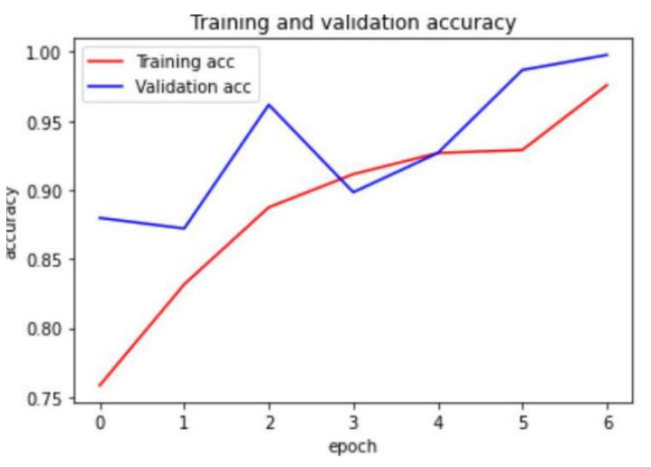
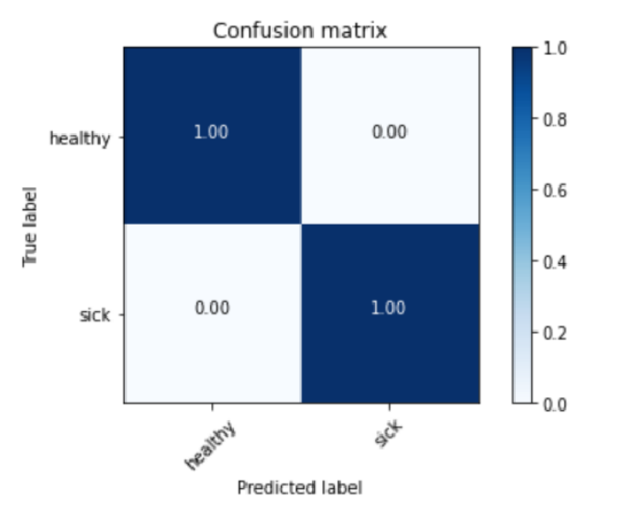
CNN produced 99.65% of accuracy with a loss of 0.0067

Slide 7
A novel Approach for Breast Cancer Detection using Data Mining Techniques
by Chaurasia and Pal (2017)

Slide 8
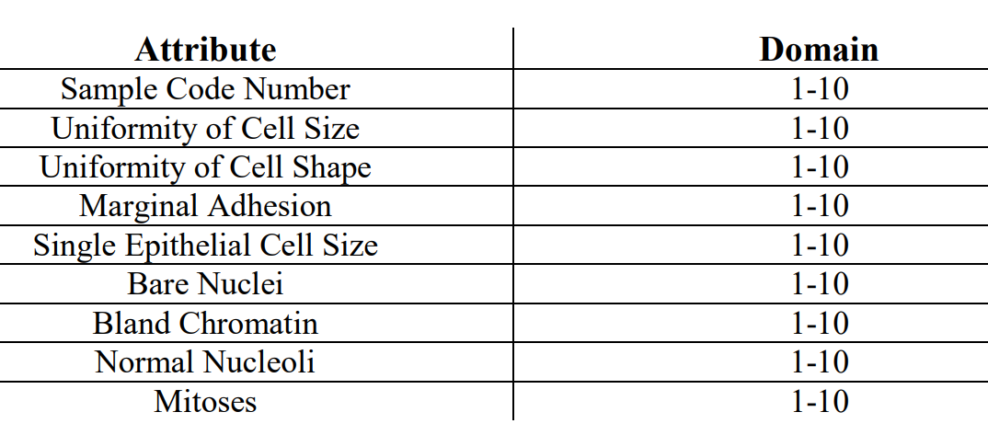
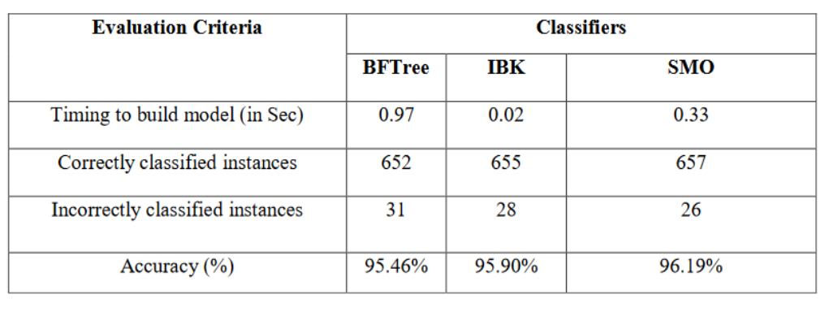
In the experiment, the used data contains 683 rows and 10 columns and it is referred to Wisconsin dataset. The label of the data contains two classes, namely malignant and benign. The remaining 9 features are as follows:
3 classification ML models have been utilized, such as Best First tree (BF tree), K Nearest Neighbors (IBK) and Sequential Minimal Optimization (SMO). According to the experiments, the authors stated that SMO provided the highest accuracy among the selected ML algorithms. The authors achieved 96.19% of accuracy with SMO algorithms, while it was 95.46% and 95.90% in BFTree and IBK algorithms respectively.

Slide 9
A Comparative Analysis of Breast Cancer Detection and Diagnosis Using Data Visualization and Machine Learning Applications
by Fatih (2020)

Slide 10
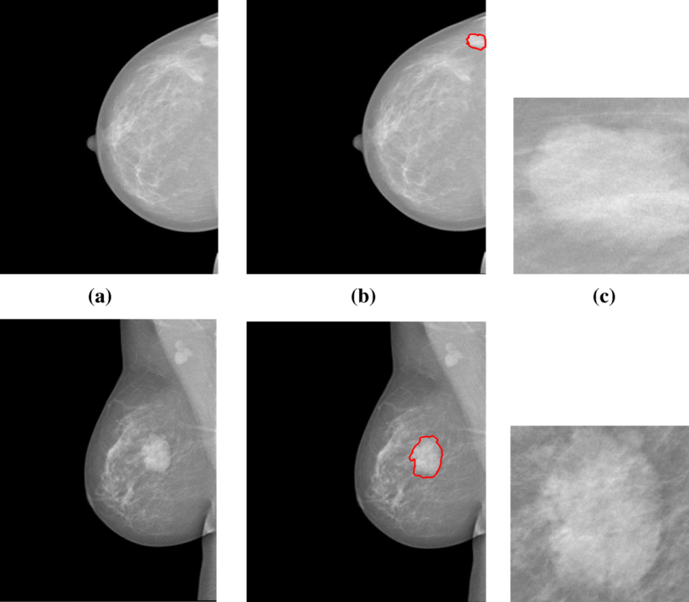
The author referred the data from breast cancer tumors from Dr.William H. Walberg of University of Wisconsin Hospital and applied various ML techniques, such as logistic regression, KNN, Support Vector Machine (SVM), Naïve Bayes, decision tree, random forest and rotation forest. Based on the experimented tests, Logistic Regression is stated to perform better performance with the accuracy value of 98.1% among the mentioned algorithms. KNN is applied with 10, 12, and 10 neighbors sequentially and the random state was defined as 42. Based on the selected neighbors, the accuracies were obtained accordingly 96.49%, 95.32%, and 94.69%. SVM technique was applied to get better accuracy scores. However, before application of the algorithm, a random state was defined as 1, not 42, since it gave better results. SVM accuracy results were obtained as 96.49%, 96.49%, and 93.85%. Naïve Bayes method gave the worst accuracy result compared to the other methods.

Slide 11
Using Machine Learning Algorithms for Breast Cancer Risk Prediction and Diagnosis
by Asri, Mousannif, Moatassime, Noel (2016)

Slide 12
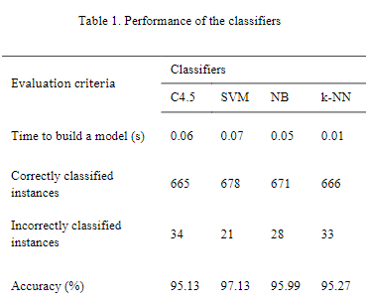
KNN, SVM, NB, C4.5 algorithms are applied to conduct the experiment. The data is obtained from Wisconsin. General, 699 instances are taken, and only 458 out of them are benign. The number of the features are 11.
SVM was able to show its power in terms of effectiveness and efficiency based on accuracy and recall.

Slide 13
Recommended Papers:
Dubey, A.K.; Gupta, U.; Jain, S. Analysis of k-means clustering approach on the breast cancer Wisconsin dataset. Int. J. CARS 2016, 11, 2033–2047
Bray, F.; Ferlay, J.; Soerjomataram, I. Global cancer statistics 2018: GLOBOCAN estimates of incidence and mortality worldwide for 36 cancers in 185 countries. CA Cancer J. Clin. 2018, 68, 394–424
Jothi, N.; Rashid, N.A.; Husain, W. Data mining in healthcare—A review. Procedia Comput. Sci. 2015, 72, 306–313

Slide 14

Conclusion
To sum up, CNN algorithm showed the highest result in breast cancer detection. Despite the fact that other classification algorithms also produced satisfactory results, CNN required less feature engineering method to catch the patterns. While variety of the engineering methods were required to be implemented in algorithms, such as Logistic Regression, RF, SVM, etc., CNN, by the help of the built-in libraries in python, required less manual jobs to be trained. Beside the advantageous side, CNN produced 99.67% of accuracy.

Slide 15
References
Viswanatha Reddy Allugunti. Breast cancer detection based on thermographic images using machine learning and deep learning algorithms. Int J Eng Comput Sci 2022;4(1):49-56.
Chaurasia, Vikas & Pal, Saurabh. (2014). A Novel Approach for Breast Cancer Detection using Data Mining Techniques. International Journal of Innovative Research in Computer and Communication Engineering. 3297. 2320-9801.
Ak, Muhammet Fatih. (2020). A Comparative Analysis of Breast Cancer Detection and Diagnosis Using Data Visualization and Machine Learning Applications. Healthcare. 8. 111. 10.3390/healthcare8020111.
Hiba Asri, Hajar Mousannif, Hassan Al Moatassime, Thomas Noel, Using Machine Learning Algorithms for Breast Cancer Risk Prediction and Diagnosis, Procedia Computer Science, Volume 83, 2016, Pages 1064-1069, ISSN 1877-0509, https://doi.org/10.1016/j.procs.2016.04.224.

